Slide 1
Traffic Intersection Control
Christopher Makarem
Keshav Tadimeti
EE 3, Spring 2016

Slide 2
The challenge
Create a system that simulates a 4-way traffic intersection
There’s a catch, however…
It detects whether or not cars are present on its own and responds accordingly
the system doesn’t just follow a traffic light routine

Slide 3
The challenge – traffic lights
Source: http://static3.businessinsider.com/image/512785e369bedd8f75000010-400-300/you-can-even-put-traffic-lights-inside-cars.jpg

Slide 4
The challenge - Detection
Source: http://static3.businessinsider.com/image/512785e369bedd8f75000010-400-300/you-can-even-put-traffic-lights-inside-cars.jpg

Slide 7
Breaking it down – Three issues
Create light-switching system
Detect whether cars are present
Create emergency bypass signal to simulate emergency vehicles getting right of way to pass through

Slide 8
Light-switching
Arduino:
Programmable
Can read voltage on pins as logic
Output voltage HIGH (1) or LOW (0) based on logic

Slide 9
Detect Cars
Hall Effect Sensor:
Detects magnetic field
Latching switch device (normally closed)
Identifies when car is present

Slide 10
Emergency bypass
IR Photodiode:
Detects infrared light
Restricts voltage flow based on light intensity
Simulates emergency vehicles

Slide 11
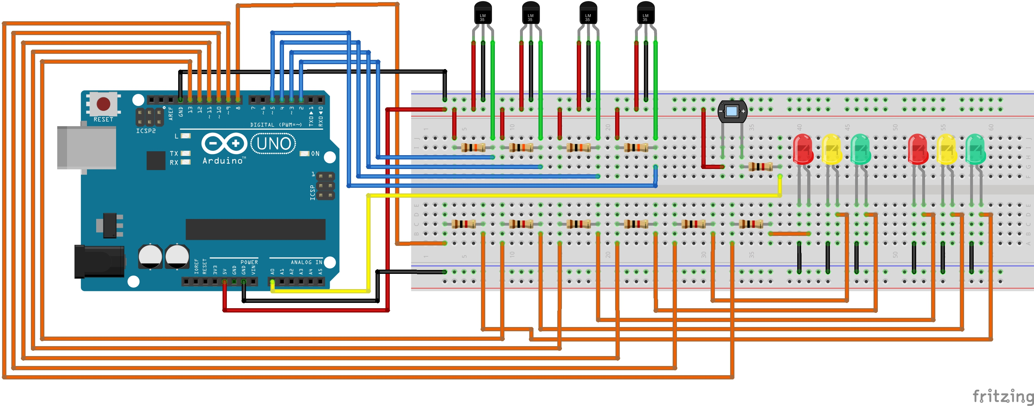
The circuit - Model
Arduino
Hall effect sensor
IR Photodiode
Indicator LEDs

Slide 12
3d model
Indicator LED
Arduino
Hall effect sensor

Slide 13
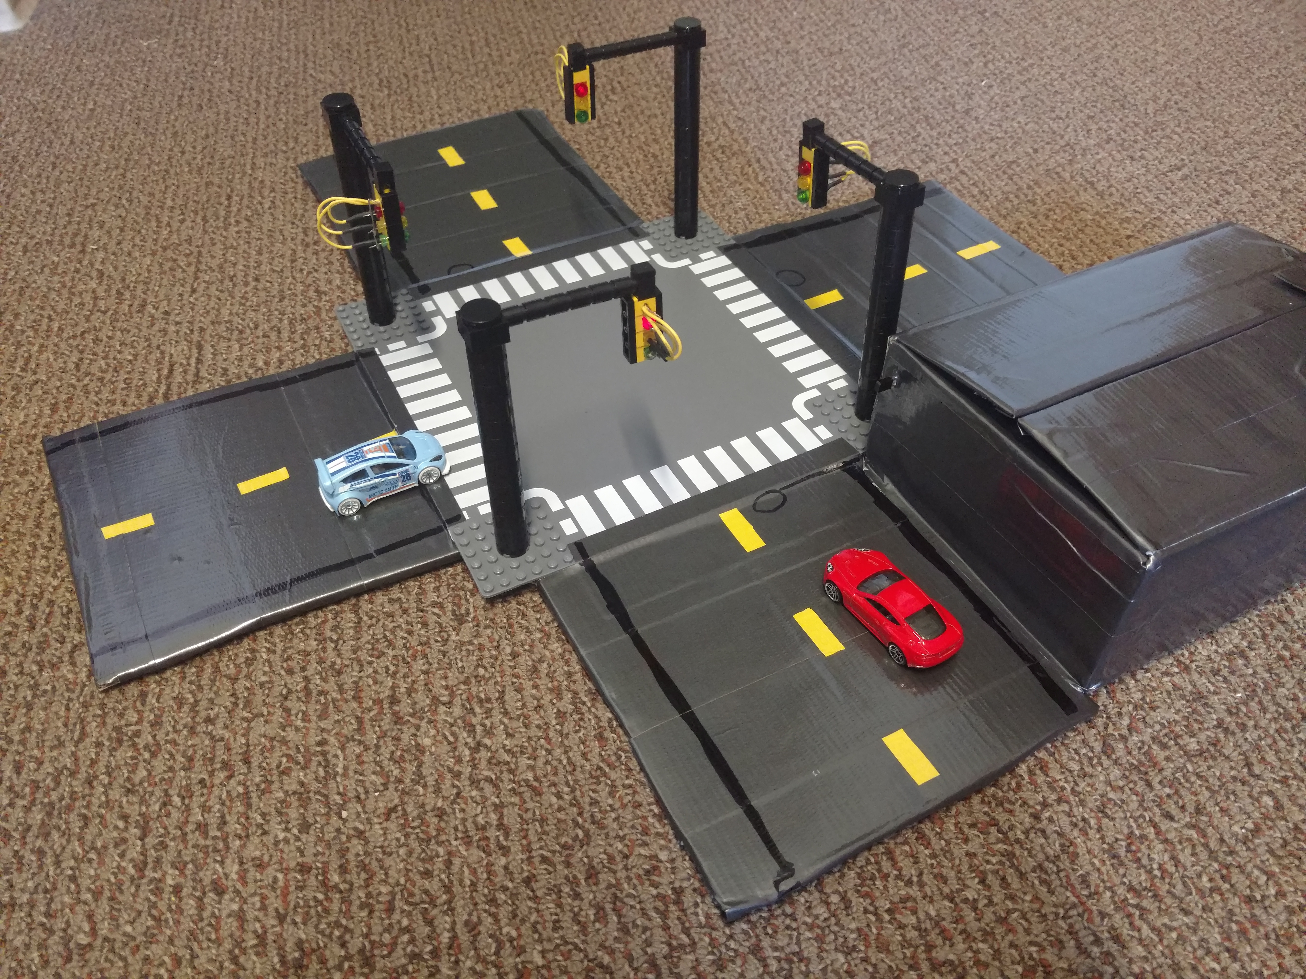
The finished product
Indicator LED
IR Photodiode
Hall effect sensor
Arduino

Slide 14
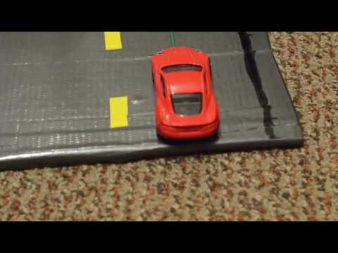
Demonstration video

